Slide 1
Statistical Modelling and Machine Learning
Linear Regression

Slide 2
Regression
In regression the output is continuous
Many models could be used – Simplest is linear regression
Fit data with the best hyper-plane which "goes through" the points
y
dependent
variable
(output)
x – independent variable (input)

Slide 3
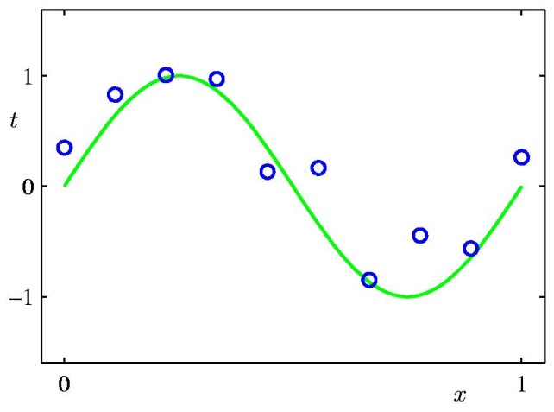
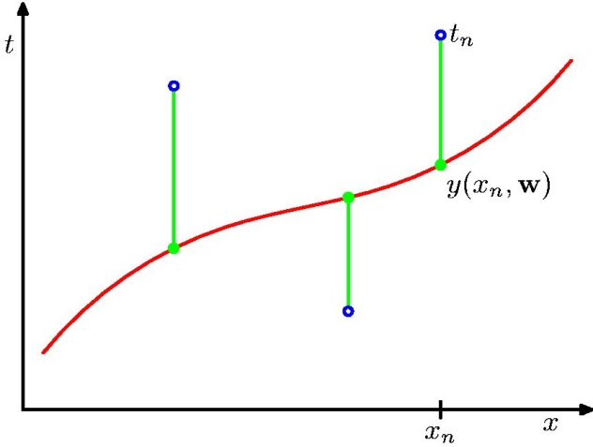
A Simple Example: Fitting a Polynomial
The green curve is the true function (which is not a polynomial)
We may use a loss function that measures the squared error in the prediction of y(x) from x.
from Bishop’s book on Machine Learning

Slide 4
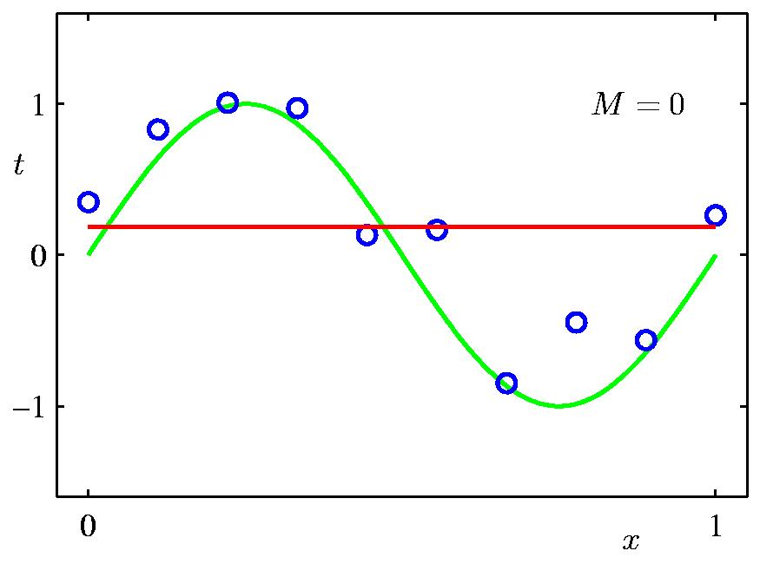
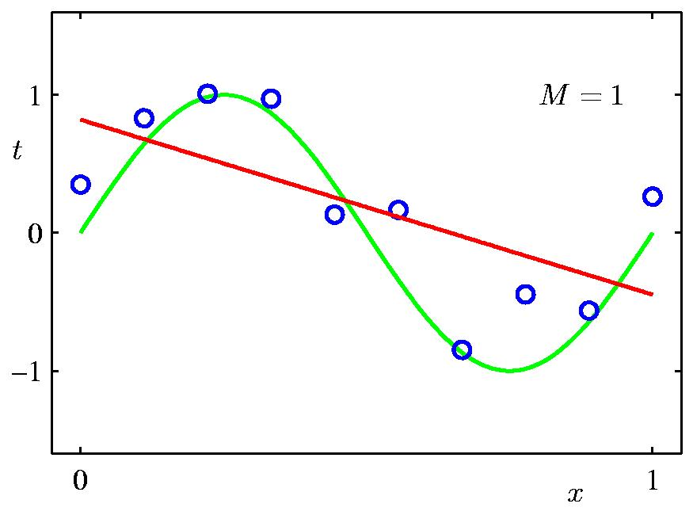
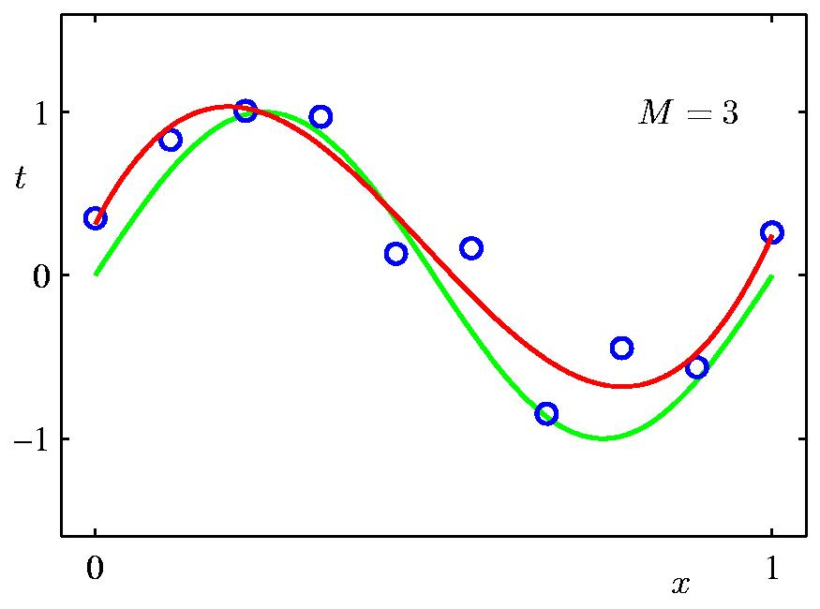
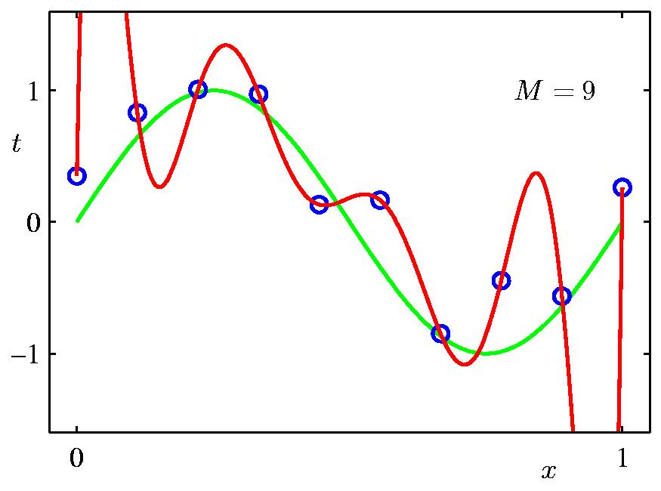
Some fits to the data: which is best?
from Bishop

Slide 5
Types of Regression Models
Regression
1 feature
Models
2+ features
Simple
Multiple
Non-
Non-
Linear
Linear
Linear
Linear
Notes:
24
This teleology is based on the number of explanatory variables & nature of relationship between X & Y.

Slide 6
Linear regression
Given an input x compute an output y
For example:
- Predict height from age
- Predict house price from house area
- Predict distance from wall from sensors
Y
X

Slide 7
Simple Linear Regression Equation
E(y)
Regression line
Intercept
β₀
Slope β₁
x

Slide 8
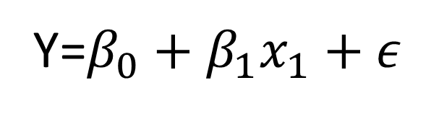
Linear Regression Model
Relationship Between Variables Is a Linear Function
Population Y-Intercept
Population Slope
Random Error
Y=$β_{0}+β_{1}x_{1}+ε$

Slide 9
House Number | Y: Actual Selling Price | X: House Size (100s ft2)
1 | 89.5 | 20.0
2 | 79.9 | 14.8
3 | 83.1 | 20.5
4 | 56.9 | 12.5
5 | 66.6 | 18.0
6 | 82.5 | 14.3
7 | 126.3 | 27.5
8 | 79.3 | 16.5
9 | 119.9 | 24.3
10 | 87.6 | 20.2
11 | 112.6 | 22.0
12 | 120.8 | .019
13 | 78.5 | 12.3
14 | 74.3 | 14.0
15 | 74.8 | 16.7
Averages | 88.84 | 18.17
Sample 15 houses from the region.

Slide 10
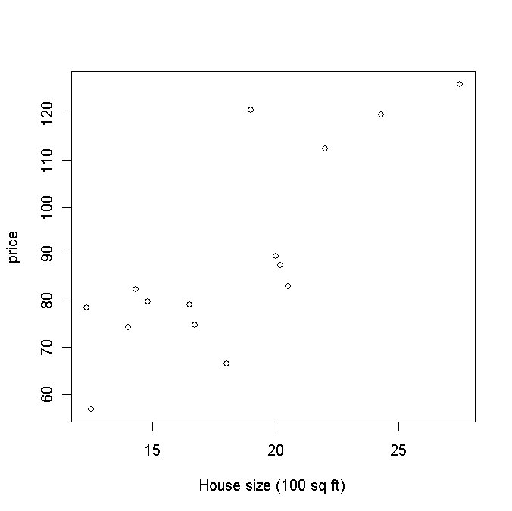
House price vs size

Slide 11
Linear Regression – Multiple Variables
β₀ is the intercept (i.e. the value for Y if all the X’s are zero), β_{j} is the slope for the jth variable X_{j}

Slide 12
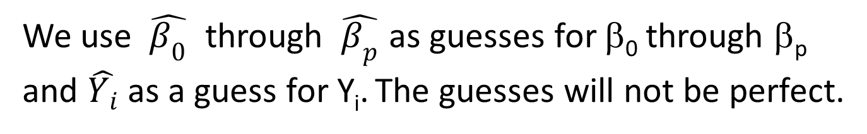
Regression Model
Our model assumes that
E(Y | X = x) = β₀ + β₁x (the “population line”)
Population line
Least Squares line
We use $\hat{β_{0}}$ through $\hat{β_{p}}$ as guesses for β₀ through β_{p} and $\hat{Y_{i}}$ as a guess for Y_{i}. The guesses will not be perfect.

Slide 13
Assumption
The data may not form a perfect line.
When we actually take a measurement (i.e., observe the data), we observe:
Y_{i} = β₀ + β₁X_{i} + ε_{i},
where ε_{i} is the random error associated with the ith observation.

Slide 14
Assumptions about the Error
E(ε_{i} ) = 0 for i = 1, 2,…,n.
σ(ε_{i} ) = σ_{ε} where σ_{ε} is unknown.
The errors are independent.
The ε_{i} are normally distributed (with mean 0 and standard deviation σ_{ε}).

Slide 15
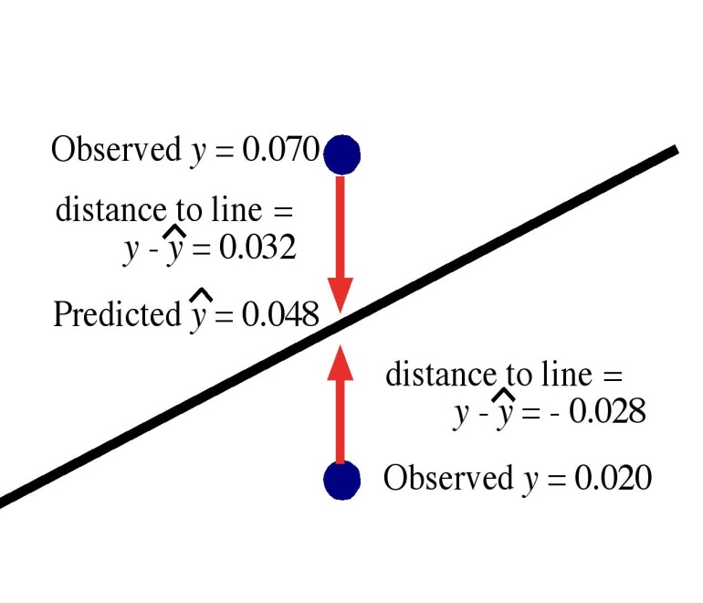
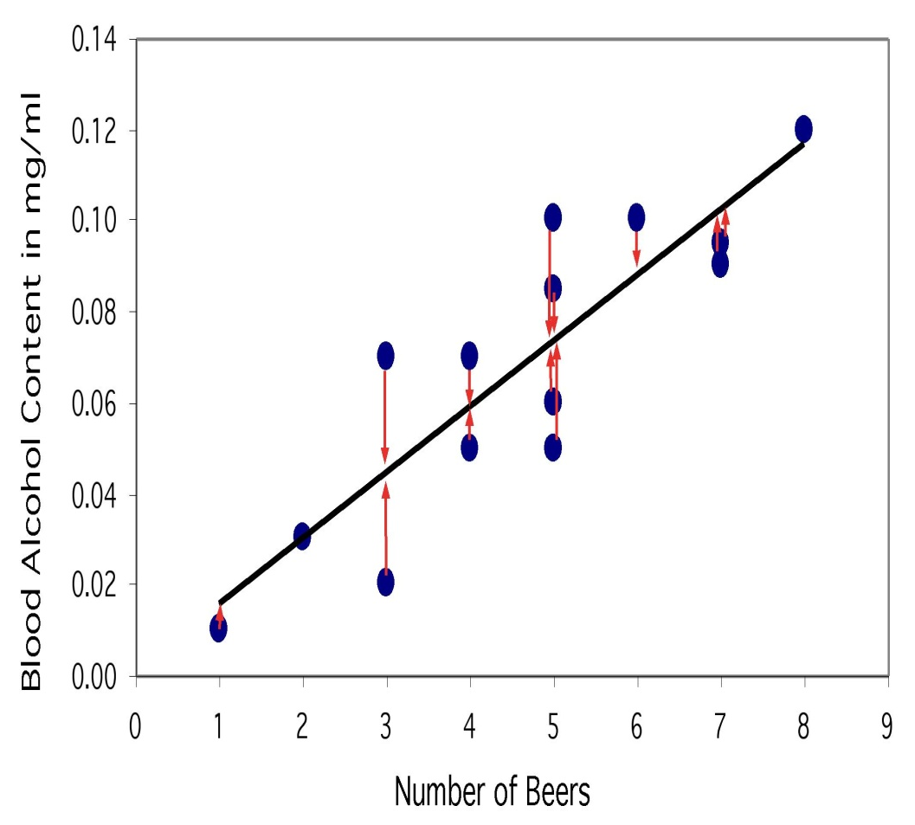
The regression line
The least-squares regression line is the unique line such that the sum of the squared vertical (y) distances between the data points and the line is the smallest possible.

Slide 16

Criterion for choosing what line to draw: method of least squares
The method of least squares chooses the line ( $\hat{β_{0}}$ and $\hat{β_{1}}$ ) that makes the sum of squares of the residuals $\sum{{ℇ_{i}}^{2}}$ as small as possible
Minimizes

Slide 17
How do we "learn" parameters
For the 2-d problem
To find the values for the coefficients which minimize the objective function we take the partial derivates of the objective function (SSE) with respect to the coefficients. Set these to 0, and solve.

Slide 18
Thank You

